Slide 1
Digital Portfolio
STUDENT NAME:
REGISTER NO AND NMID:
DEPARTMENT:
COLLEGE: COLLEGE/ UNIVERSITY

Slide 2
PROJECT TITLE
Students Digital Portfolio

Slide 3


AGENDA
Problem Statement
Project Overview
End Users
Tools and Technologies
Portfolio design and Layout
Features and Functionality
Results and Screenshots
Conclusion
Github Link
3/21/2024 Annual Review

Slide 4

PROBLEM STATEMENT
Manual attendance systems are time-consuming, prone to errors, and can be easily manipulated. There is a need for a smart and automated solution to track student attendance accurately and efficiently.

Slide 5

PROJECT OVERVIEW
This project presents a face recognition-based attendance system that automatically records attendance by detecting and recognizing student faces in a classroom setting. It leverages computer vision and machine learning algorithms to ensure accurate identification and real-time logging of attendance.

Slide 6

WHO ARE THE END USERS?
Educational Institutions (Schools, Colleges, Universities)
Teachers and Administrative Staff
Students

Slide 7

TOOLS AND TECHNIQUES
Programming Language: Python
Libraries/Frameworks: OpenCV, NumPy, dlib, face_recognition
Database: SQLite
IDE: Visual Studio Code
Others: Tkinter for GUI, Jupyter Notebook for initial prototyping

Slide 8
POTFOLIO DESIGN AND LAYOUT
Homepage: Project Title, Student Name, and Navigation Menu
About Section: Problem statement, objectives, tools used
Gallery Section: Screenshots and system workflow
Project Demo Page: Embedded video or GIF of the working system
Documentation Section: PDF or text explanation of each module
Contact Page: Email ID or social links for queries
8

Slide 9
FEATURES AND FUNCTIONALITY
Face Detection and Recognition
Real-time Attendance Marking
Attendance Report Generation (Date-wise)
Admin Login and Dashboard
Student Data Management
GUI Interface for User Interaction

Slide 10
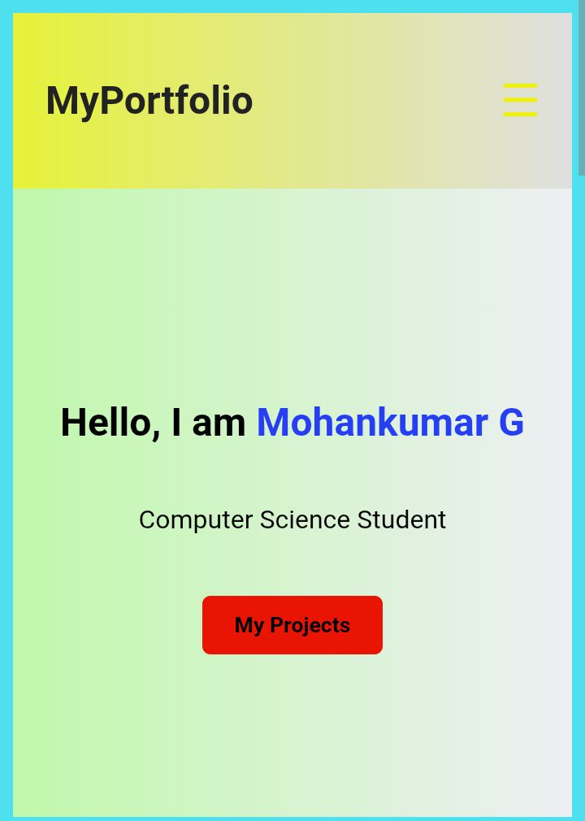
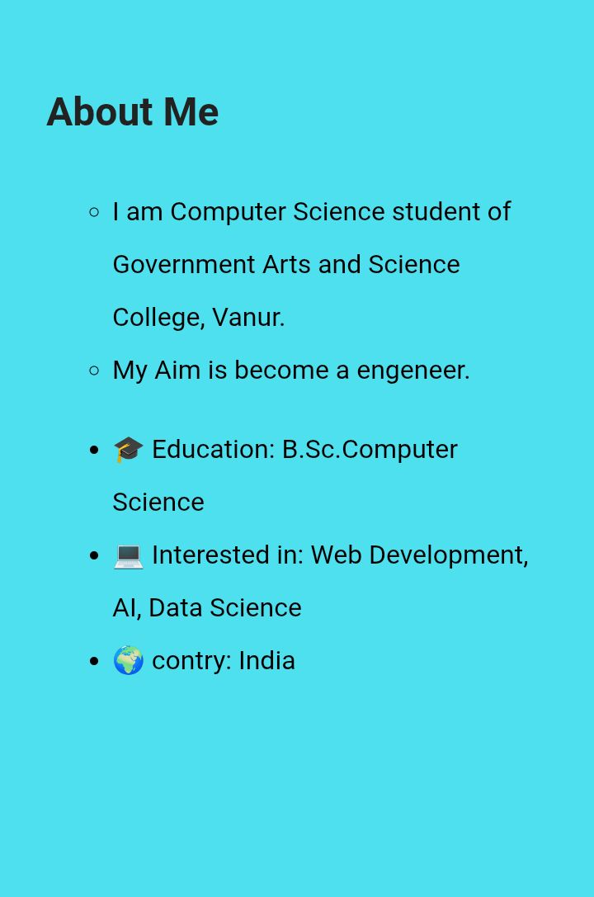

RESULTS AND SCREENSHOTS
3/21/2024 Annual Review
10

Slide 11
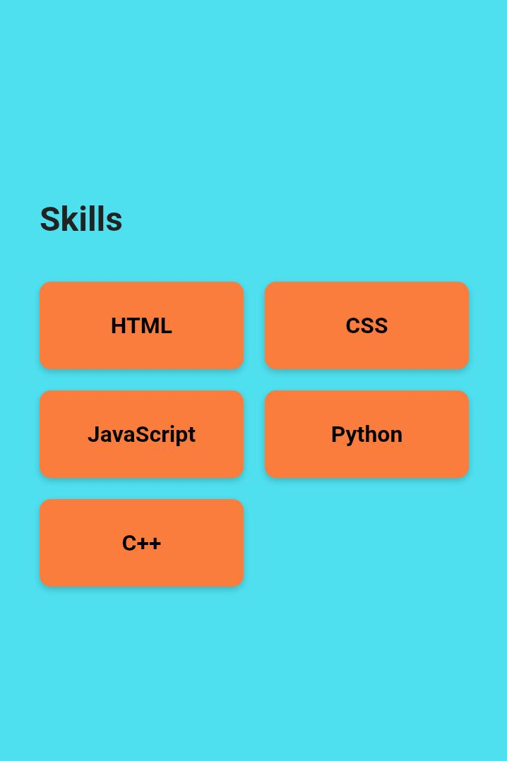

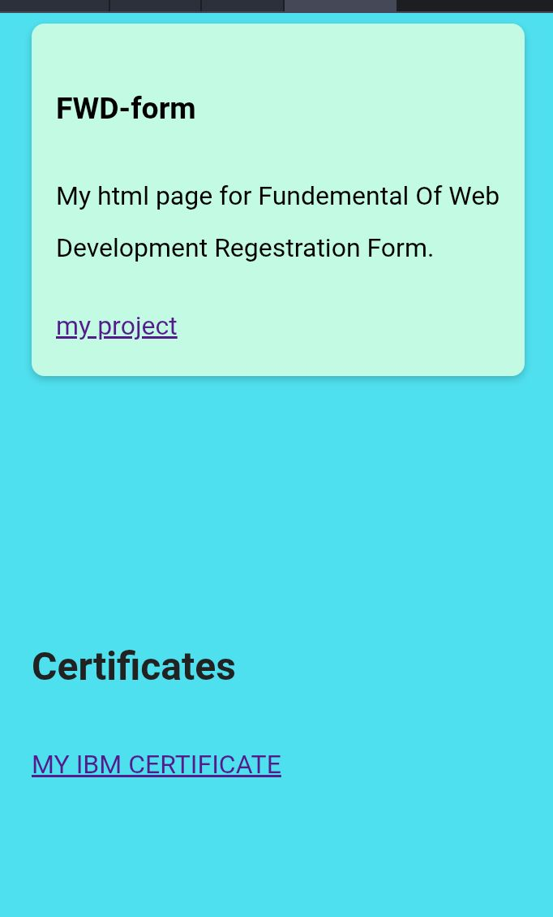
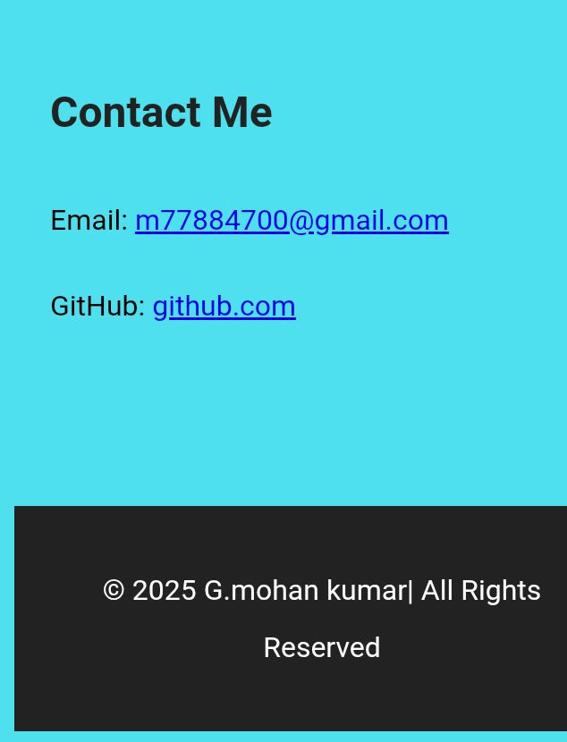
Results And Screenshots

Slide 12
CONCLUSION
The Smart Attendance System using Face Recognition successfully automates the attendance process with enhanced accuracy and minimal human intervention. The use of AI and real-time video processing demonstrates the potential of technology in transforming traditional educational processes. This project can be scaled further by integrating it with cloud-based databases and mobile apps for enhanced usability.
12

Slide 13
GitHub Link
https://github.com/m77884700-sketch/Mohankumar-G-TNSDC-FWD-DP

